Slide 1
CST 311
Final Review
A lot of different pieces of ideas, concepts, technologies and protocols come together to create the Internet
Understanding these helps us be better ________

Slide 2
Difficult class?

Slide 3
Broad Themes
Layering
Packet traversal/encapsulation
Network Architecture
IP Addressing
Web browsing example
Performance
Protocols
Security

Slide 4
Layering
Breakdown communication responsibility
Make hard problems easier
Details

Slide 5
Packet traversal
Application creates message and sends through socket to transport layer
Transport layer adds its envelope and sends to IP layer
Source IP and Destination IP added at IP layer along with other envelope information to packet
Data link layer adds envelop and follows medium access rules to send frame to gateway
Packet travels up to IP layer - routing table is used to figure out the next hop
Depending on the next hop, appropriate data link layer to send the frame (source and destination IP remain the same, while at the data link layer the addresses are changed to be in a different envelope)
So on all the way until the destination is reached

Slide 6
Network Architecture
Internet is a ‘Network of networks’
Internet Protocol – “thin waist”
Routing based on network part of IP address
Applications on the Internet
Client/Server
Peer-to-peer
__________

Slide 7
IP Adressing
Hosts
Need to have IP address to communicate
Need gateway address to “see” Internet
Host-only networking
Initialization (Power on)
ARP
DHCP

Slide 8
Browsing example
Host has IP Address, Gateway address and DNS Server address configured (Manual or DHCP)
User enters www.csumb.edu in the browser
Browser opens UDP socket to local DNS server and send request
Browser gets response from DNS with IP address for www.csumb.edu
Browser opens TCP socket to the IP address of www.csumb.edu
TCP Connection Established
Browser sends HTTP Get message on the TCP Connection
Browser receives HTTP response
Browser displays data on the screen

Slide 9
Packet arrival
Frame arrives at the destination data link layer
After any error checking, sends to IP layer
IP looks at the destination address and recognizes that the packet is meant for itself - send packet up to transport layer after removing IP envelop
Transport layer will process based on whether TCP or UDP
Send to Application layer after removing transport envelope

Slide 10
Performance
End to end delay
Processing
Transmission
Propagation
Queuing
Capacity
Bandwidth
Throughput

Slide 11
Protocols
Rules for communication
Precise computer science skills
HTTP
TCP
IP
ARP
CSMA/CA
...

Slide 12
Security
Confidentiality
Integrity
Availability
Authentication
Authorization
Symmetric Encryption
Public Key Encryption
Public Key Infrastructure
Security at each layer (each link)

Slide 13
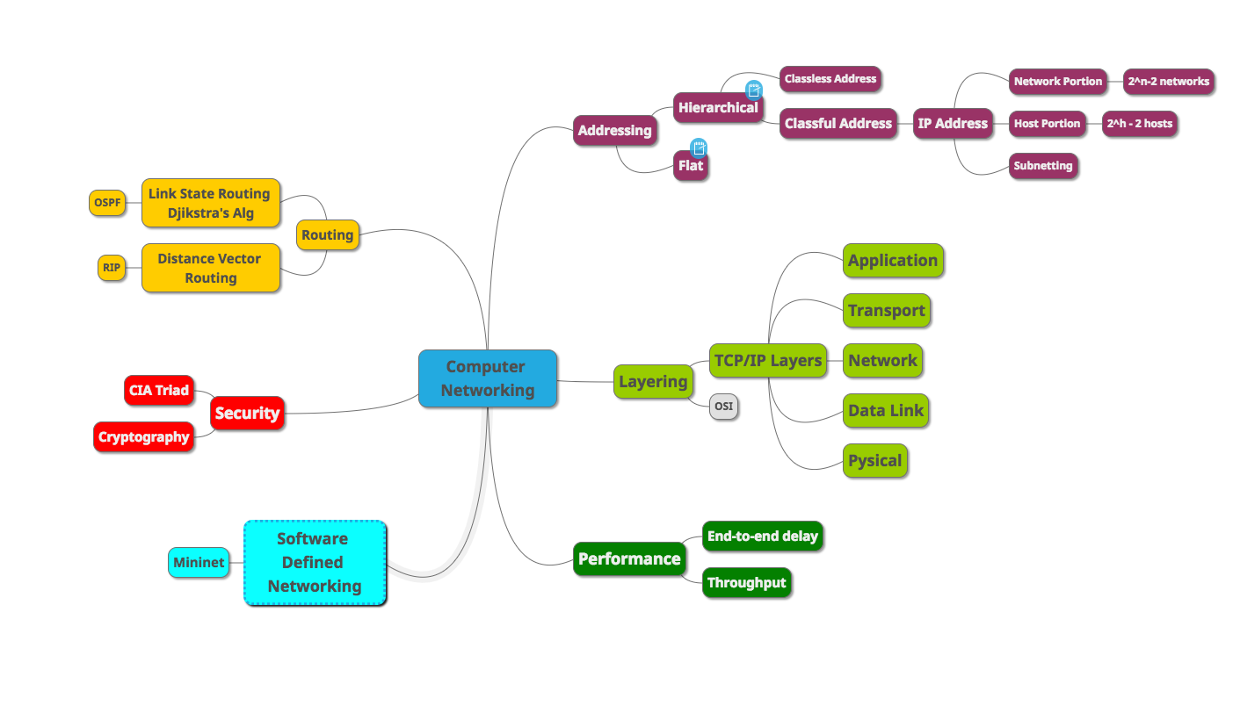
Concept map
Use this as starting point and add more leaves and notes.

Slide 14
Meta
Problem Solving
Virtual Machines
Unix command line
Debugging networking problems
ifconfig
ping
Learning from online resources
Apply Networking Concepts to Other Fields
Separation of concerns
Protocol development

Slide 15
Going forward

Slide 16
Above & Beyond
Pick a project of personal interest
Read challenging material in your field of interest
Curate your social media followings

Slide 17
Cultivate
Positive attitude &
Growth mindset

Slide 18
Good luck!
Let me know how I can help you!
(Connect with me on LinkedIn)

